Slide 1


supervised
Dr Asir Ajmal

Slide 2

Topic
Portrayal of women
in Punjabi film songs

Slide 3

Conducted by innocents

Slide 4
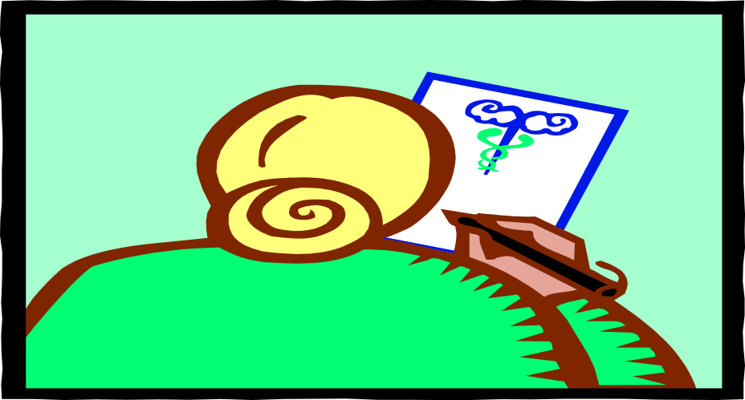
CONDUCTED BY
507
512

Slide 5
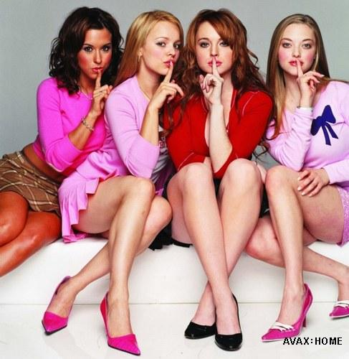

Slide 6


Message formats for media

Slide 7

Hoo-ha audiences

Slide 8


Ha-ha

Slide 9
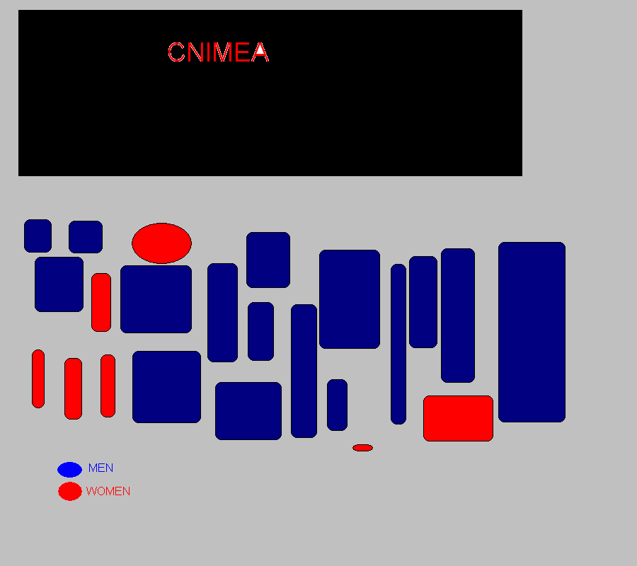

Slide 10

Supervised by
Dr asir ajmal

Slide 11



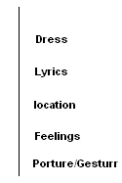
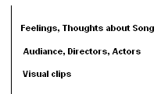
Flow chart based on the steps covered in research
Four individuals separately watch the song.

Slide 12
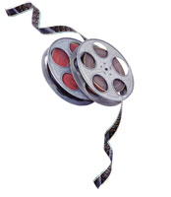
Methodology

Slide 13

memo

Slide 14

Procedure of song analysis &data generation
Song
memo
Cross comments
Coding
Final

Slide 15
Result
Final memo
Coding
Individual generated comments
Each person of group Cross read each memo separately
Separate Memo & margined comments
Watched by four people of group separately
Film song

Slide 16
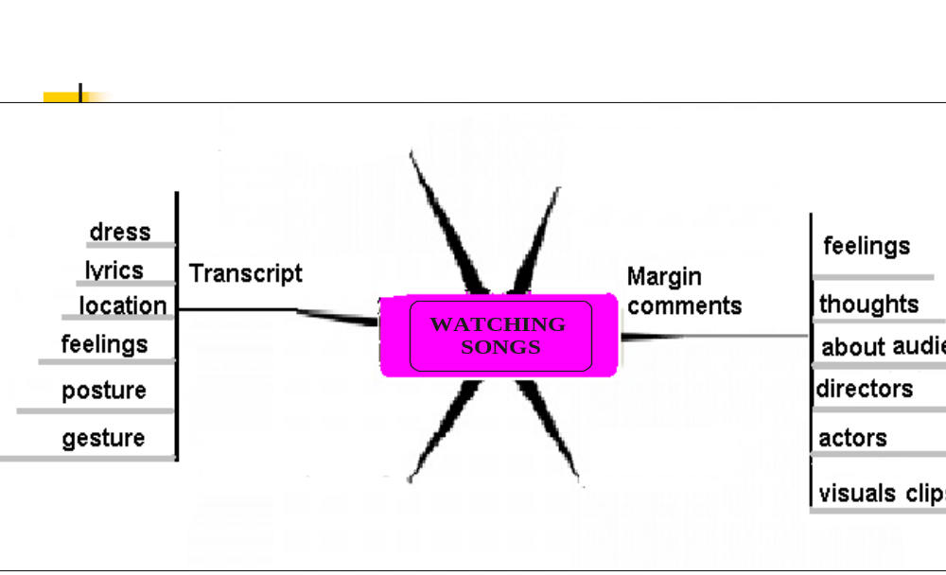
Graphical representation
Of watching song & memo writing

Slide 17
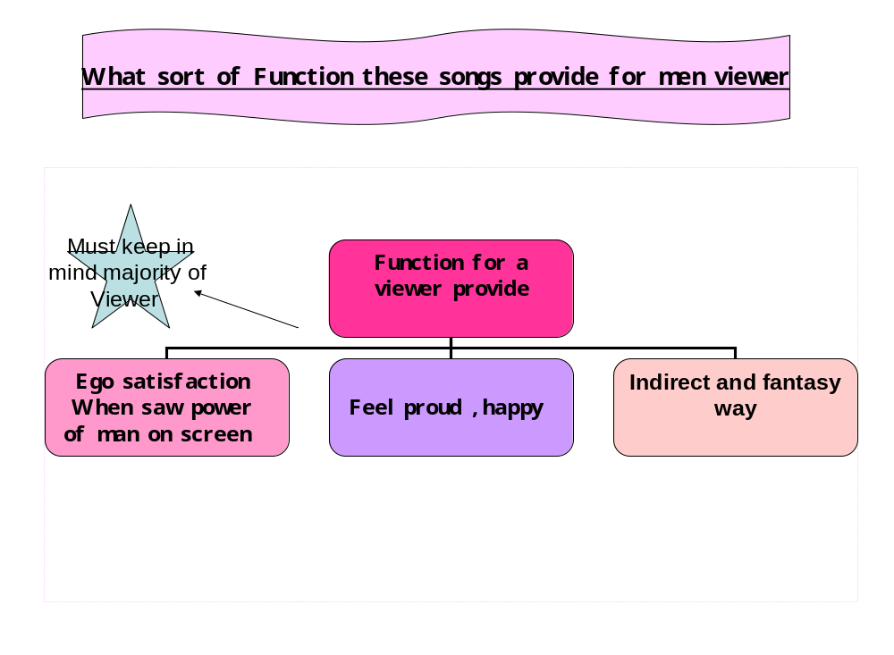

Slide 18
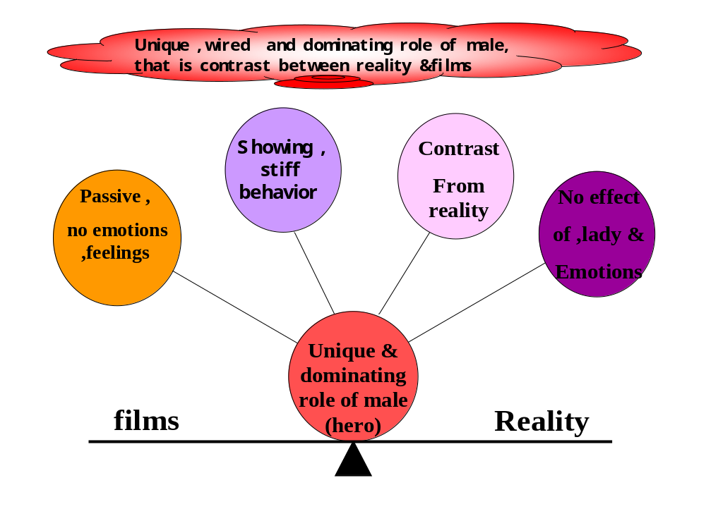

Slide 19
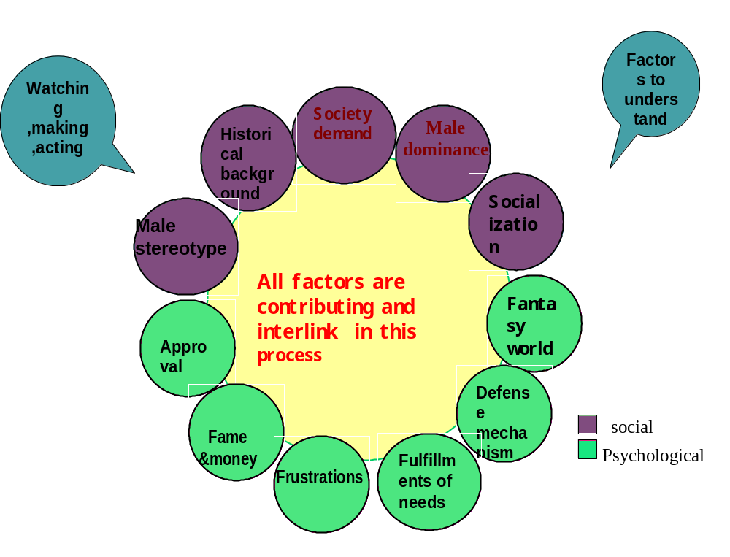

Slide 20
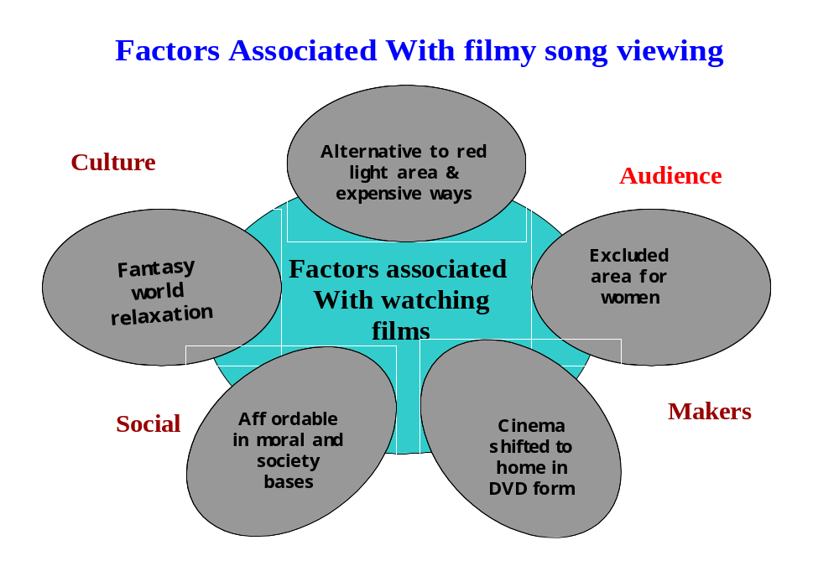

Slide 21
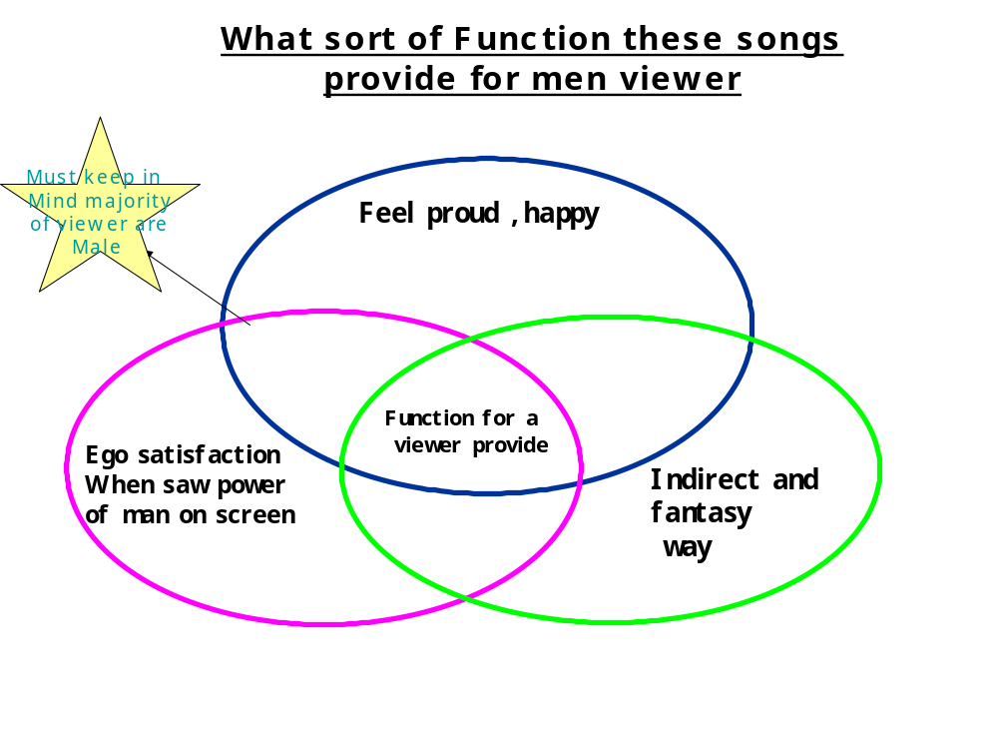

Slide 22
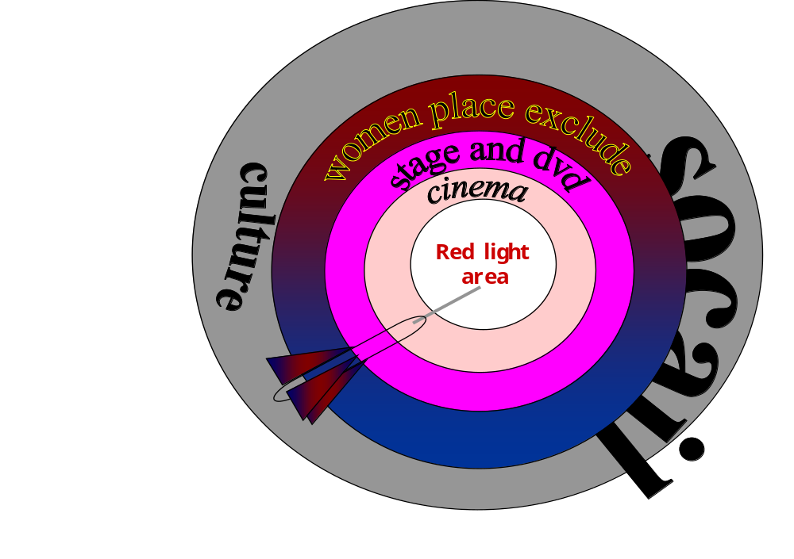

Slide 23
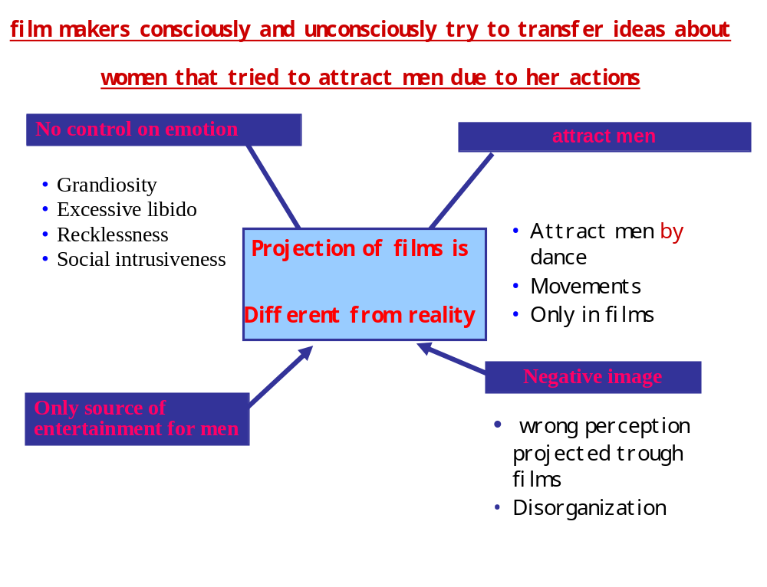

Slide 24
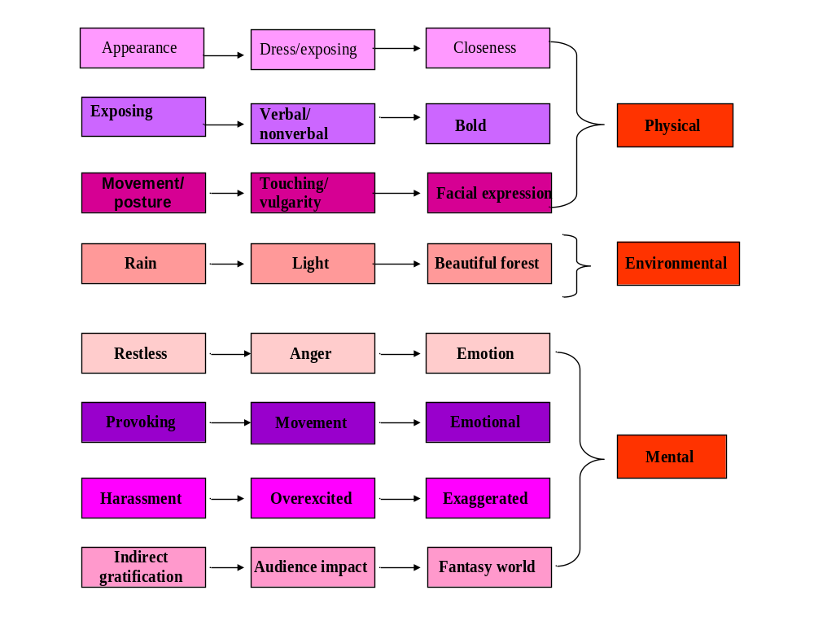

Slide 26
song
Transcript
Margin comments

Slide 28
Methods for assessing song
data
Song
Utilization data
analysis
and pools
informants
Individual

Slide 29
Assessment techniques
song assessment helps identify and measure gaps between what is and what ought to be wrong .
The song assessment process includes:
1
Gathering data
2
Analyzing the data
3
Establishing priorities for addressing the problem

Slide 30
Approach to
S
Write a simple STATEMENT
E
Provide
E
Give

Slide 31
Result materials for different target groups
Message for Decision-
makers
1. Issue/Problem
2. Size
Message for and Allies
3. Effects
4. Action
Message for Resistant Groups

Slide 32

See

Slide 33


Watch it

Slide 34


Slide 35

Hmm

Slide 36

Madam

Slide 37

Sir

Slide 38
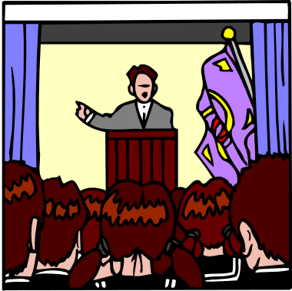
Presenter

Slide 39

Reviewed by others

Slide 40

Others group gossip about us

Slide 41
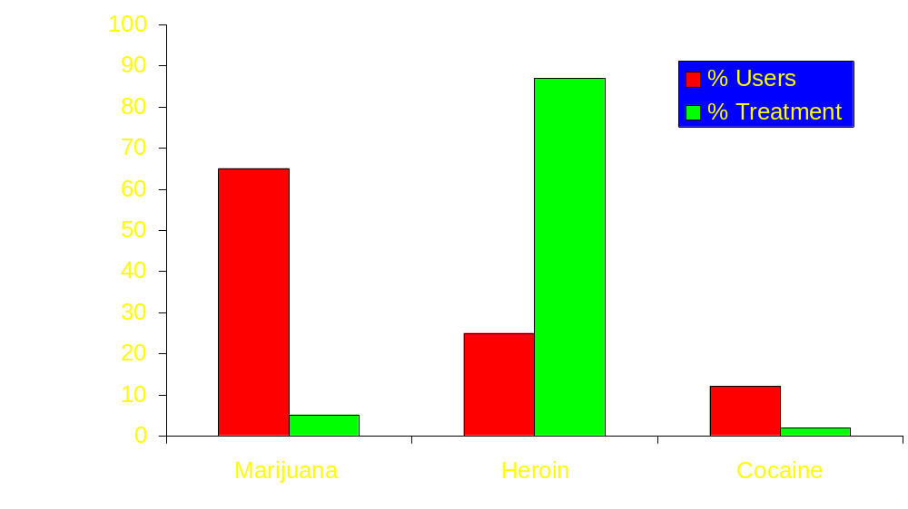

Slide 42
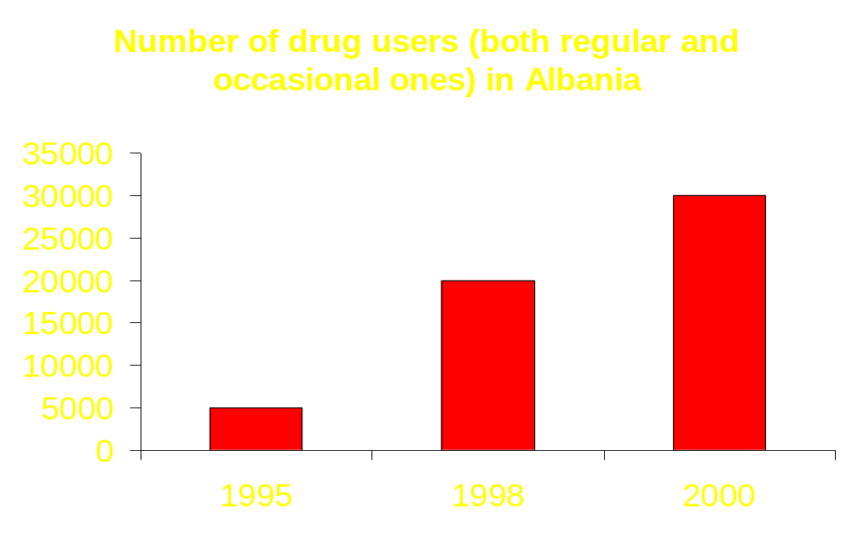

Slide 43

Comments

Slide 44
Suggestions

Slide 45
Key Facts
Youngsters and Media
  Media Use and Effects
  Media Ratings Systems
  Media Policies and Practices

Slide 46
Key Facts
Children & Media
✓ Media habits
✓ Addictive media behavior
✓ Aggression & anti-social behaviors
✓ Desensitization
✓ Mean world syndrome
✓ Early sexual activity
✓ Body image and self-esteem
✓ Substance use
✓ Other risky lifestyle choices
✓ Academic performance
✓ And more . . .
Understanding Media’s Influence
 Social Cognitive Theory
 Cultivation Analysis

 Third-Person Effects
Media Industry Policies & Practices
Children’s Television Act
V-Chip and TV Parental Guidelines
Media Ratings & Parental Advisories
FTC Marketing Violence to Children

Slide 47
3 + Way Partnership
Audiences
Actors
directors

Slide 48
= Missing Link as Teachers to Media Literacy
Audiences
Cinema
directors
Actors

Slide 49
BUILDING BRIDGES
Partnership
Audiences
Cinemas
Bridge to Media Literacy
Actors
directors
Theaters

Slide 50


Slide 51
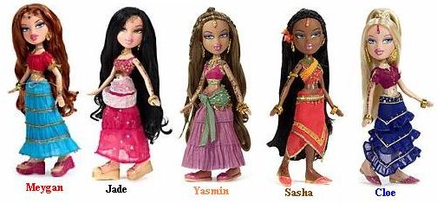

Slide 52
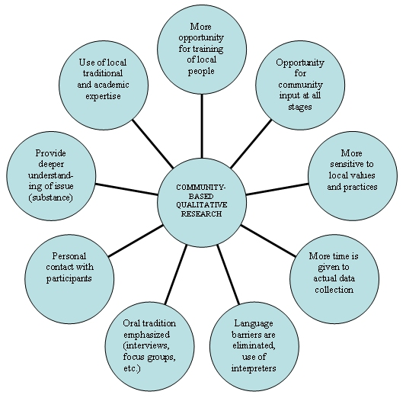

Slide 53
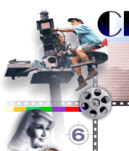

Slide 54
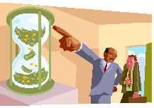

Slide 55


Slide 56
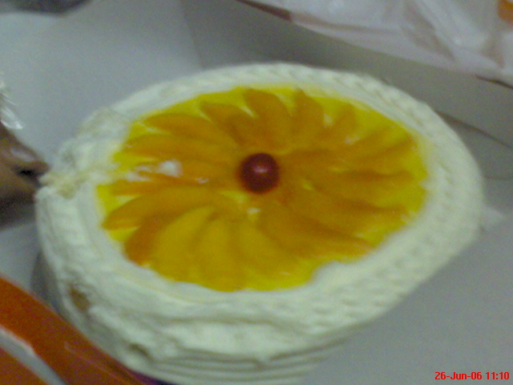

Slide 57
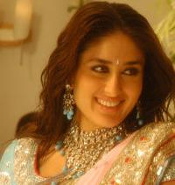

Slide 58
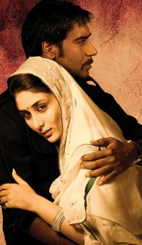

Slide 59
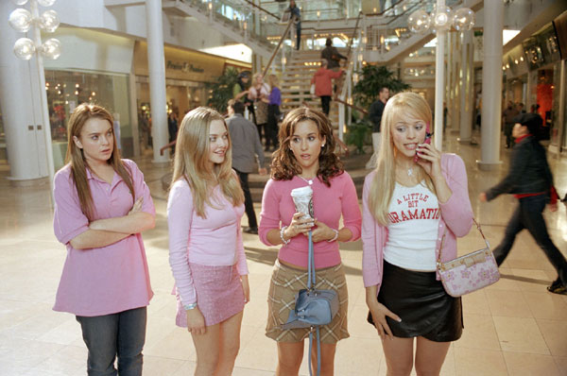

Slide 60
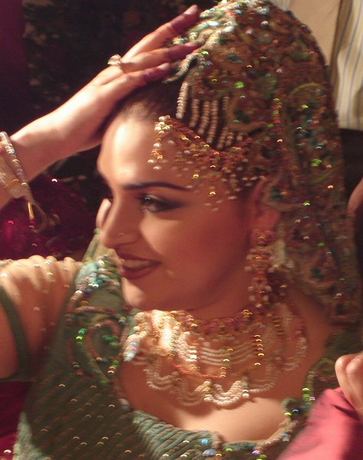

Slide 61


Slide 62
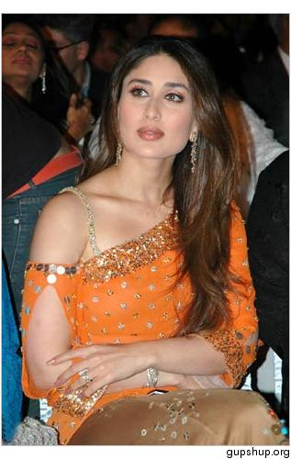

Slide 63
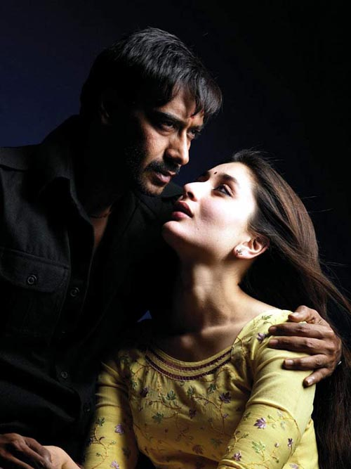

Slide 64


Slide 65


Slide 66


Slide 67


Slide 68


Slide 69
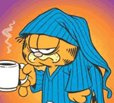

Slide 70
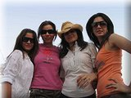

Slide 71
Data Ordering (3)
Data Collection (2)
Theoretical Sampling (1)

Slide 72
Open Coding
Open coding is the part of the analysis concerned with identifying, naming, categorizing and describing phenomena found in the text. Essentially, each line, sentence, paragraph etc. is read in search of the answer to the repeated question "what is this about? What is being referenced here?"
These labels refer to things like hospitals, information gathering, friendship, social loss, etc. They are the nouns and verbs of a conceptual world. Part of the analytic process is to identify the more general categories that these things are instances of, such as institutions, work activities, social relations, social outcomes, etc.

Slide 73
Methods
The basic idea of the grounded theory approach is to read (and re-read) a textual database (such as a corpus of field notes) and "discover" or label variables (called categories, concepts and properties) and their interrelationships. The ability to perceive variables and relationships is termed "theoretical sensitivity" and is affected by a number of things including one's reading of the literature and one's use of techniques designed to enhance sensitivity.
Of course, the data do not have to be literally textual -- they could be observations of behavior, such as interactions and events in a restaurant. Often they are in the form of field notes, which are like diary entries.

Slide 74
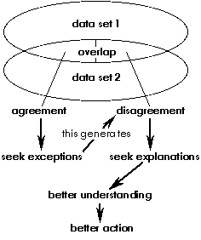

Slide 75
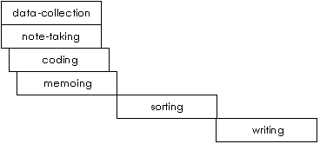

Slide 76
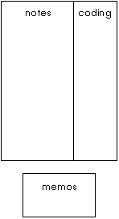

Slide 77


Slide 78


Slide 79
Women Exploitation
Phase1 Watching movies
Transcript
Margin comments
Phase 2 Mamo
Comments
Cross checking
Phase 3 Coding
Phase 4 categories
Phase 5 Results
Dress
Lyrics
Location
Feelings
Thought
Audience
Director
Actors

Slide 80
Watching Song
. Transcript
Margin Comments
Dress
location Lyrics
feel
Feelings/thoughts
Audience, directors, actors
Nayla
Misbah
Tina
Rabbia
Separately watch the song

Slide 81
Memo
comments
crosschecking
Categories
Results

